Slide 1

Game Programming, KFUPM
SWE 402, Lecture 3
Game Development Technology
Dr. Omar Hammad, KFUPM
Notes:
PRESENTER SCRIPT Ok, now — all of you have great ideas. That’s the fun part. But ideas alone aren’t enough. Games must *feel* good. And when I say “feel good,” I mean pixels, frames, and milliseconds. Today I’ll give you a quick tech overview so you can reason about performance and smoothness across PCs, consoles, and different screens. VISUAL / BUILD NOTES Cover image is a motherboard close-up (public domain). If you want a different cover vibe (e.g., game art collage), replace the background image. SOURCES Cover background: Wikimedia Commons (Computer Motherboard Closeup, CC0).

Slide 2
Pixels, Frames, Milliseconds.
Feel is Technical
Notes:
PRESENTER SCRIPT Keep this sentence in mind: “feel is technical.” We’re going to connect your design ideas to the hardware + software pipeline that makes the game responsive and smooth. VISUAL / BUILD NOTES Minimal slide: big statement only. Pause for 2 seconds before continuing.

Slide 3



What is the difference between these three clips ..
Tetris
Super Mario World
Call of Duty
Notes:
PRESENTER SCRIPT Imagine three clips: 1) A Tetris-like block falling. 2) A platformer jump. 3) A heavy 3D action fight. Question: what’s different between them? Is it just art style? Or do they demand different hardware and software pipelines? Also: Tetris falling “slowly” is mostly *rules* — but hardware determines whether the game can keep updates smooth. VISUAL / BUILD NOTES The three panels are custom placeholder illustrations (no copyrighted game screenshots). If you prefer real clips, replace panels with 3 short embedded videos (or stills) you own the rights to. SOURCES Custom image generated in this deck.

Slide 4
Can we run modern 3D games on old hardware?

Slide 5
Things that change if hardware is weaker ..
Resolution ↓
FPS target ↓
Lighting ↓
4K → 720p
60 → 30
fewer dynamic lights
Textures ↓
Effects ↓
Simulation ↓
lower detail, shorter distance
fewer particles, reflections
Simpler AI/physics
Notes:
PRESENTER SCRIPT If we try to run a “modern” 3D game on weaker hardware, what changes? Usually: lower resolution, lower FPS target, simpler lighting, lower detail, fewer effects, and sometimes simpler AI/physics. This is the key idea: performance is a *budget*, not a mystery. VISUAL / BUILD NOTES These are the standard downgrade levers you can mention when students ask: “what would be different?”

Slide 6
What is FPS?
Notes:
So what is is FPS btw?

Slide 7

What are video?
Notes:
let's go to a much broader question. What are videos? is this real?

Slide 8

flipbook
Notes:
Actually videos are nothing more than static images that are presented very quickly after one another.

Slide 9
What about Refresh Rate?
Notes:
What about Refresh rate? refresh rate is the number of images that the screen can show measured in Hz

Slide 10
Let’s define hardware..
Notes:
Now, let's move on to defining the relevent hardware components ..

Slide 11
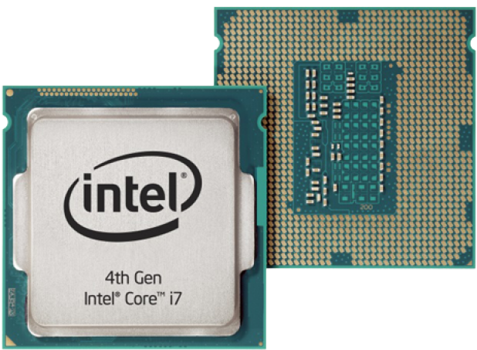
CPU → Build speed + simulation
Compiling + building projects
Gameplay logic + AI
Physics / animation updates
Preparing work for the GPU
Notes:
PRESENTER SCRIPT Start with the CPU. For developers, CPU affects how fast your code compiles and how fast tools run. During gameplay, CPU runs the simulation: AI, physics, gameplay rules, animation updates — and it also helps prepare draw calls for the GPU. VISUAL / BUILD NOTES CPU image is a close-up photo (CC0). If you prefer, replace with a modern CPU package photo. SOURCES CPU image: Wikimedia Commons “386 CPU Close-up.jpg” (CC0).

Slide 12
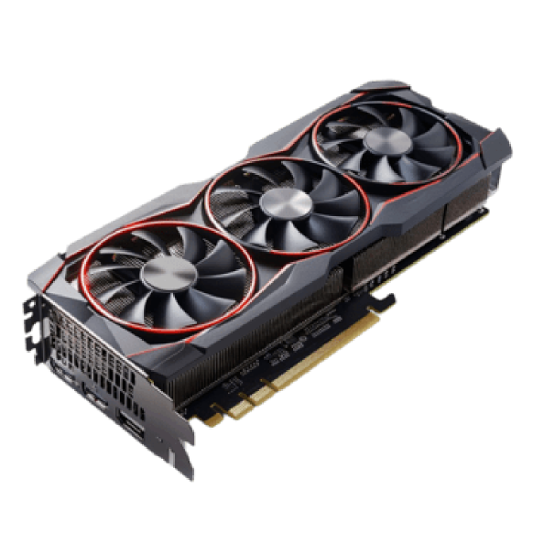
GPU → Rendering + visual complexity
Draws frames: shaders, lighting
Gets stressed by complex scenes
Common bottleneck in 3D games
Notes:
PRESENTER SCRIPT Next: GPU. The GPU is responsible for rendering — lighting, shaders, environments, and effects. If your game slows down mainly in visually heavy scenes, the GPU is often the reason. SOURCES GPU image: Wikimedia Commons “Graphic card.jpg” (CC BY-SA 3.0).

Slide 13
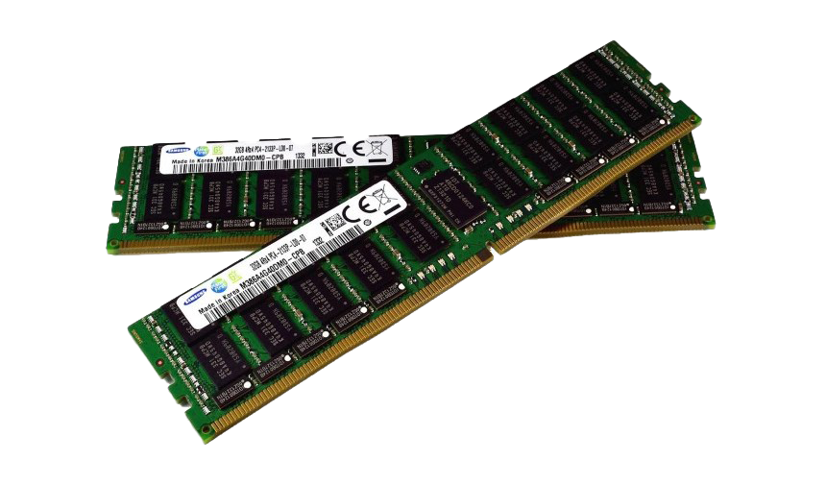
RAM → Working set while you build & play
Holds assets + data currently in use
Too little RAM → slowdowns or crashes
Big 3D projects need more
Notes:
PRESENTER SCRIPT RAM holds the temporary things you’re actively using: assets loaded into the editor, textures, meshes, level data, and runtime objects. If you run out of RAM, things get painfully slow or unstable. SOURCES RAM image: Wikimedia Commons “RAM module.jpg” (Public Domain).

Slide 14
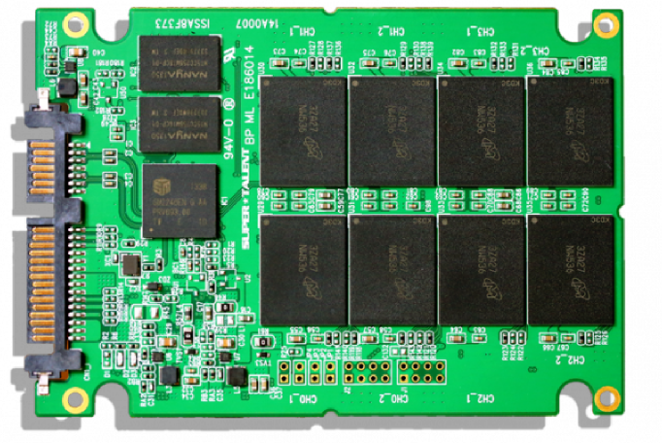
Storage (SSD) → Load times + workflow speed
Project opens faster
Assets load faster
Builds and imports are smoother
Notes:
PRESENTER SCRIPT Storage matters more than students expect. An SSD doesn’t make your GPU faster — but it makes your *workflow* faster: opening projects, importing assets, building, and loading levels. SOURCES SSD image: Wikimedia Commons “1TB 2280 NVME SSD.jpg” (CC0).

Slide 15
Let’s switch to the player side..
Notes:
Now switch perspective: the player side.

Slide 16
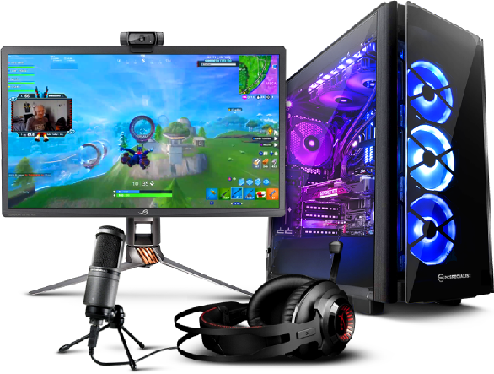
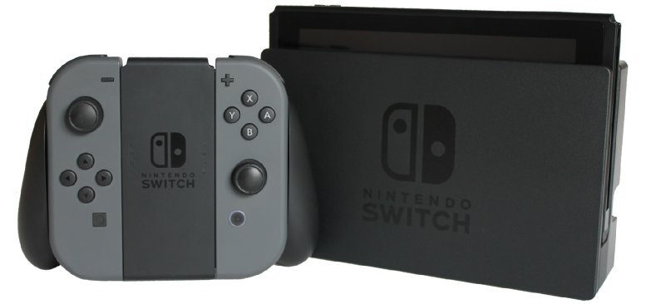
Console vs PC
Console: fixed hardware → clear target
PC: many possible hardware combos
Notes:
PRESENTER SCRIPT Consoles are different from PCs because the hardware is *fixed* within a generation. That’s good for you as a developer: you know the budget and can design for it. PC is harder: you’re shipping to many possible CPU/GPU/RAM combinations. SOURCES PS5 capabilities (4K 120Hz / VRR via HDMI 2.1): https://blog.playstation.com/2020/03/18/unveiling-new-details-of-playstation-5-hardware-technical-specs/ Xbox Series X (Up to 120 FPS, HDMI VRR): https://www.xbox.com/en-US/consoles/xbox-series-x Images: PS5 console (Wikimedia Commons, CC BY-SA), Xbox Series X photo (Wikimedia Commons), PC setup (Wikimedia Commons, CC BY-SA 2.0).

Slide 17
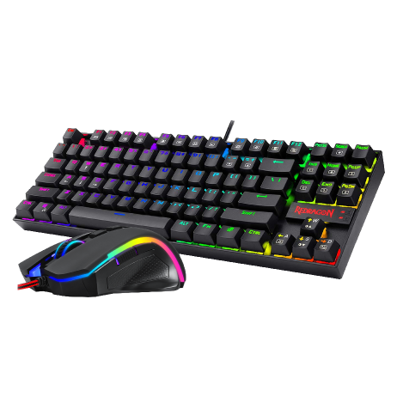
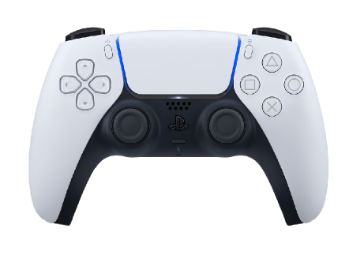
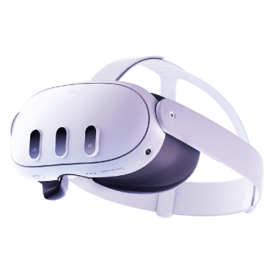
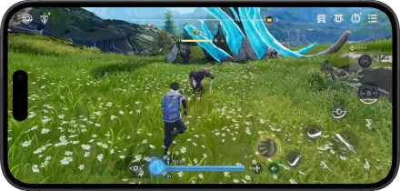
Controls → Input changes gameplay + UI
Keyboard + Mouse
Gamepad
Precision, many keys
Analog, couch play
Touch
VR / Motion
Gestures, Big UI
Immersion, Comfort
Notes:
PRESENTER SCRIPT When you design your game, always ask: what control is the player using? Keyboard+mouse feels different from a gamepad. Touch changes UI and pacing. VR has comfort limits. So input devices aren’t just hardware — they shape design decisions. VISUAL / BUILD NOTES If you want to go deeper, add one example per input: e.g., aim assist for gamepad, bigger buttons for touch. SOURCES Controller images: Wikimedia Commons (DualSense PNG; Joy-Con PNG; Xbox controller photo).

Slide 18


Game Programming, KFUPM
By Dr. Omar Hammad
join the discussion
discord.gg/jSyF3RJS
Thank you
Notes:
PRESENTER SCRIPT To conclude: technical choices shape the final experience. Hardware specs define budgets. Engines and tools define workflow and capability. Display and sync define smoothness. Final question: If you had to choose between higher frame rate and higher graphics quality, what do you pick — and why? If time: ask for 2–3 students to defend opposite choices. VISUAL / BUILD NOTES Use this as an engagement moment. Let the room talk for ~30–45 seconds.

Slide 19
References
Sony PlayStation Blog — PS5 technical specs (4K 120Hz, VRR via HDMI 2.1): https://blog.playstation.com/2020/03/18/unveiling-new-details-of-playstation-5-hardware-technical-specs/
Sony PlayStation Blog — PS5 VRR rollout: https://blog.playstation.com/2022/04/25/variable-refresh-rate-support-for-ps5-is-rolling-out-this-week/
Xbox — Series X specs (Up to 120 FPS, HDMI VRR / FreeSync): https://www.xbox.com/en-US/consoles/xbox-series-x
Unity Manual — system requirements (8GB RAM minimum recommended): https://docs.unity3d.com/6000.3/Documentation/Manual/system-requirements.html
Epic Games — Unreal Engine hardware/software specs (32GB RAM, 8GB+ VRAM): https://dev.epicgames.com/documentation/en-us/unreal-engine/hardware-and-software-specifications-for-unreal-engine
Godot Docs — system requirements: https://docs.godotengine.org/en/stable/about/system_requirements.html
HDMI — Variable Refresh Rate overview: https://www.hdmi.org/spec2sub/variablerefreshrate
VESA — Adaptive-Sync overview: https://vesa.org/featured-articles/vesa-adds-adaptive-sync-to-popular-displayport-video-standard/
mages (Wikimedia Commons):
Motherboard background (Computer Motherboard Closeup, CC0)
CPU (386 CPU Close-up, CC0)
GPU (Graphic card.jpg, CC BY-SA 3.0)
RAM module (Public Domain)
NVMe SSD (CC0)
PS5 + DualSense transparent (CC BY-SA)
Xbox Series X photo (Wikimedia Commons)
Controllers: DualSense PNG, Joy-Con PNG, Xbox controller photo (Wikimedia Commons)
Refresh-rate GIF (CC BY-SA 4.0)
Notes:
PRESENTER SCRIPT RAM holds the temporary things you’re actively using: assets loaded into the editor, textures, meshes, level data, and runtime objects. If you run out of RAM, things get painfully slow or unstable. SOURCES RAM image: Wikimedia Commons “RAM module.jpg” (Public Domain).

